Slide 1










Advanced Methods in an Ongoing Disease Surveillance Network Study Using the OHDSI ATLAS Data Analysis Workbench
The APHRC / LSHTM / MUBAS / CODATA Team June 26, 2023

Slide 2
Background

Slide 3
Meet the IDSR
Any community member acceptable by the community can be a community-based surveillance (CBS) focal person…
Representation could be from basic community-level services such as trained birth attendants, community or village health agents, or similar care providers, village leaders (religious, traditional or political), schoolteachers, veterinarians, health extension workers, chemical seller, and traditional healers and in many communities, a respected non-health person such as the barber, shop keeper, security personnel or grandmother who regularly talks to community members…
In the Technical Guidelines for Integrated Disease Surveillance and Response (IDSR) in the WHO Africa Region, Annex 1A provides standard case definitions for priority diseases and events
Case definitions go from rumor to suspected to probable to confirmed
Cases progress through these states, depending on triage and the follow up they receive through a public health system
The system begins with community-based surveillance focal persons and may include a clinician, a district surveillance worker and/or a lab

Slide 4
Meet the IDSR (2)
(a) Suspected case: indicative clinical picture, that is, patient will have fewer or atypical clinical features without being a confirmed or a probable case.
(b) Probable case: clear clinical picture (meets the clinical case definition) that is, patient will have typical clinical features of the illness or is linked epidemiologically to a confirmed case, but a laboratory sample cannot be taken because the case is lost or dead or a sample has been taken but was not available for laboratory testing or was not viable for sufficient laboratory testing.
(c) Confirmed case: a suspected or confirmed case verified by laboratory analysis.
Cases start as rumors or are suspected, depending on the sketchiness of symptoms/signs that are observed
Suspected cases become probable as a result of physical examination or when a more complete set of symptoms/signs are observed based on the clinical case definition
Suspected or probable cases become confirmed by way of specimens and lab results

Slide 5
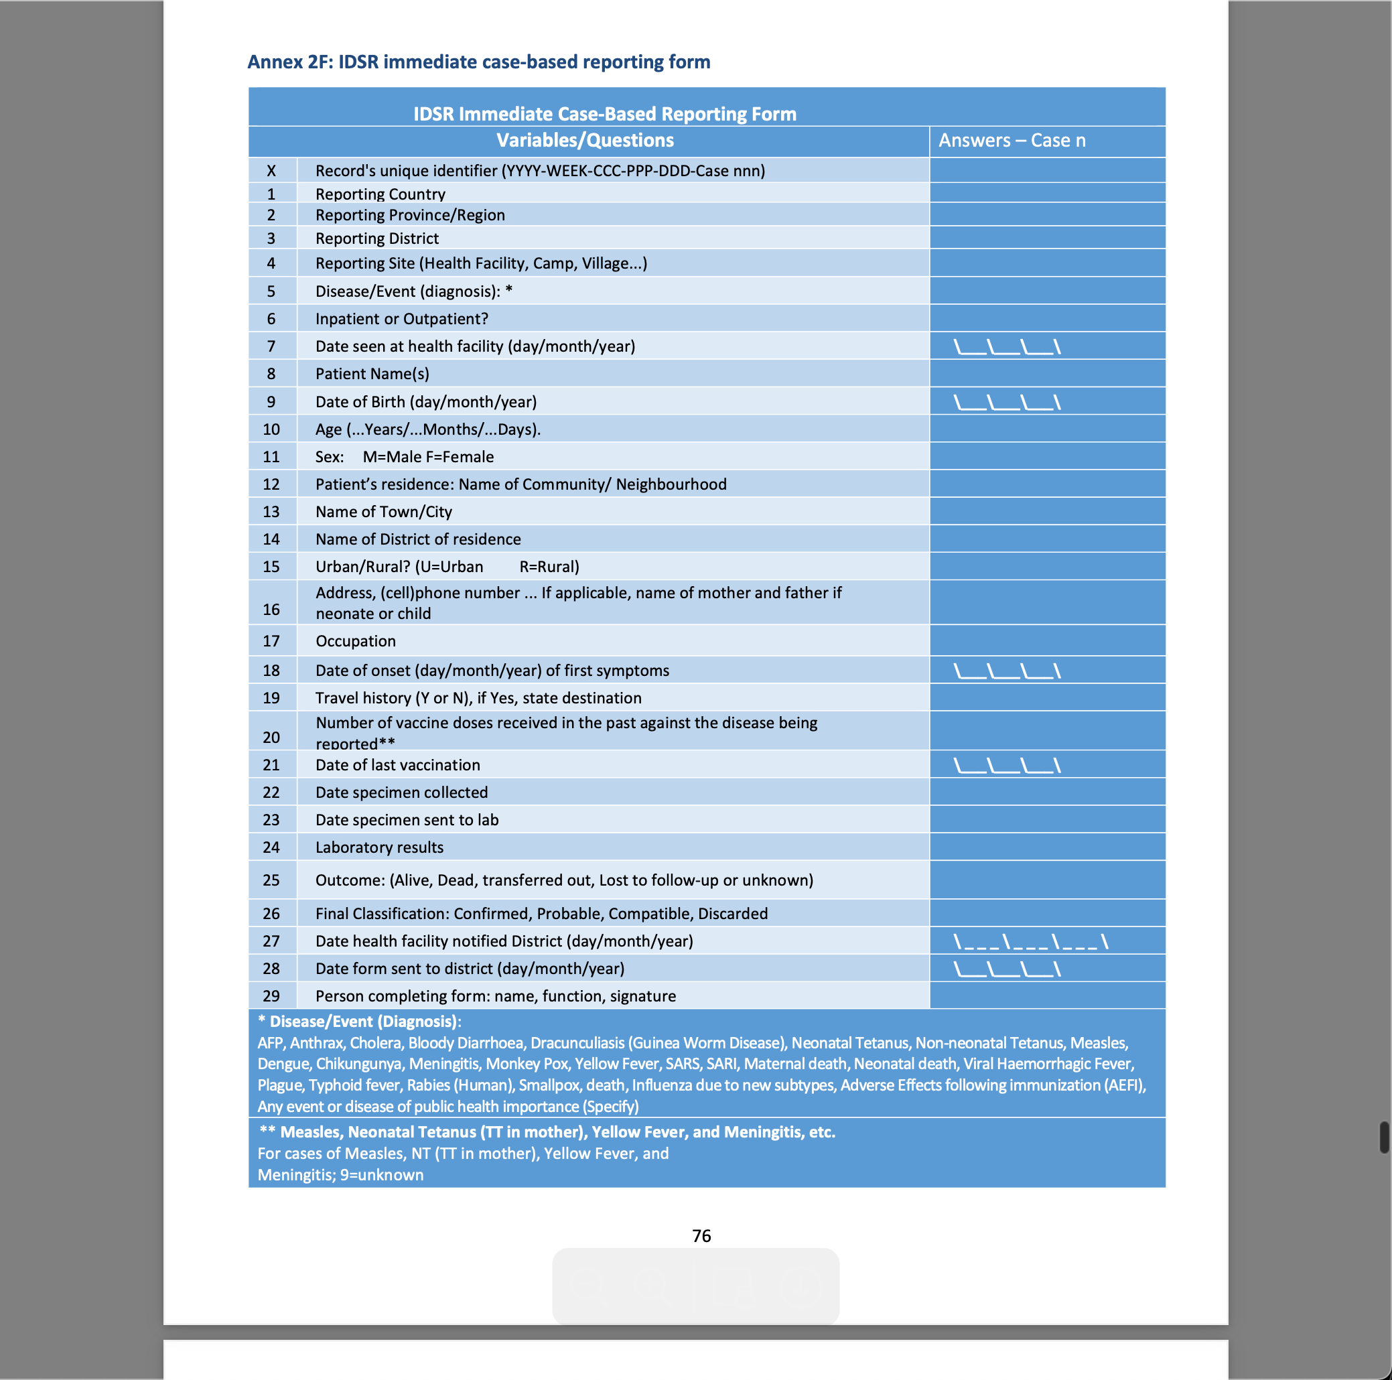
Meet the IDSR (3)
Progress through these states is recorded using the IDSR Immediate case-based reporting form
However, it is not unusual that from one country to the next in the Africa region that this form has been augmented/modified to fulfill other Ministries of Health requirements

Slide 6
Meet our OHDSI IDSR Network Study
In an OHDSI network study, several instances of OHDSI are stood up – one at each country participating in the study and one at APHRC – the coordinating center
The countries ETL their IDSR case-level data into an analysis-ready format called the OMOP Common Data Model (CDM) using SQL and/or other tools like Pentaho that the coordinating center provides
The source and OMOP CDM reformatted IDSR data is NOT shared: instead, data stay at home in each participating country
COVID-19 incidence rate and predictive analysis methods are shared back and forth between the coordinating center and participating countries
Through the back-and-forth, methods are fashioned and validated that can interoperate across countries even as these countries have adapted the IDSR to meet their own heterogeneous requirements
Let’s take each of these points one at a time…

Slide 7
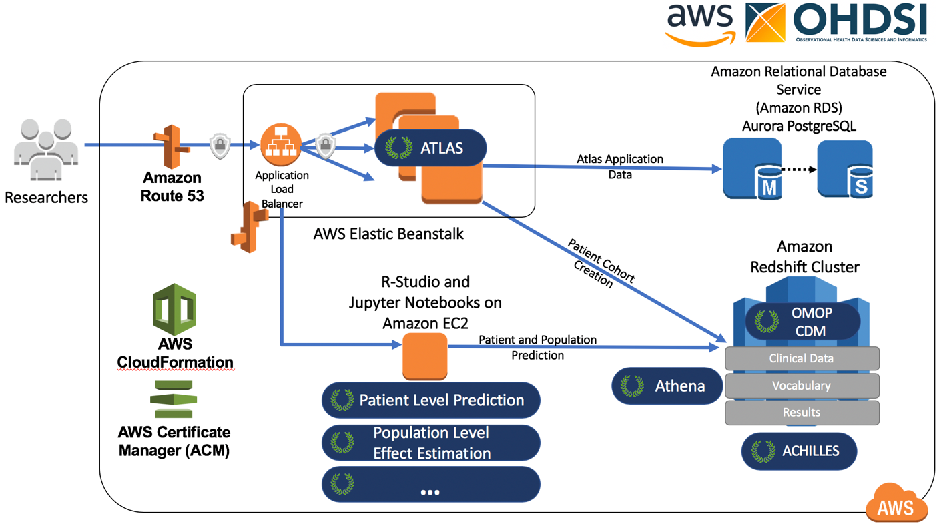
In an OHDSI network study, several instances of OHDSI are stood up…
Through a point-and-click process, codelessly, the coordinating center stood up an OMOP CDM with synthetic IDSR data and an ATLAS data analysis workbench in the public cloud version of OHDSIonAWS
Here the coordinating center, again codelessly, built and hosts the specifications for several incidence rate and predictive analyses
They, in turn, reference and use several cohort definitions and concept sets that are the building blocks of all the analyses that OHDSI and ATLAS support

Slide 8
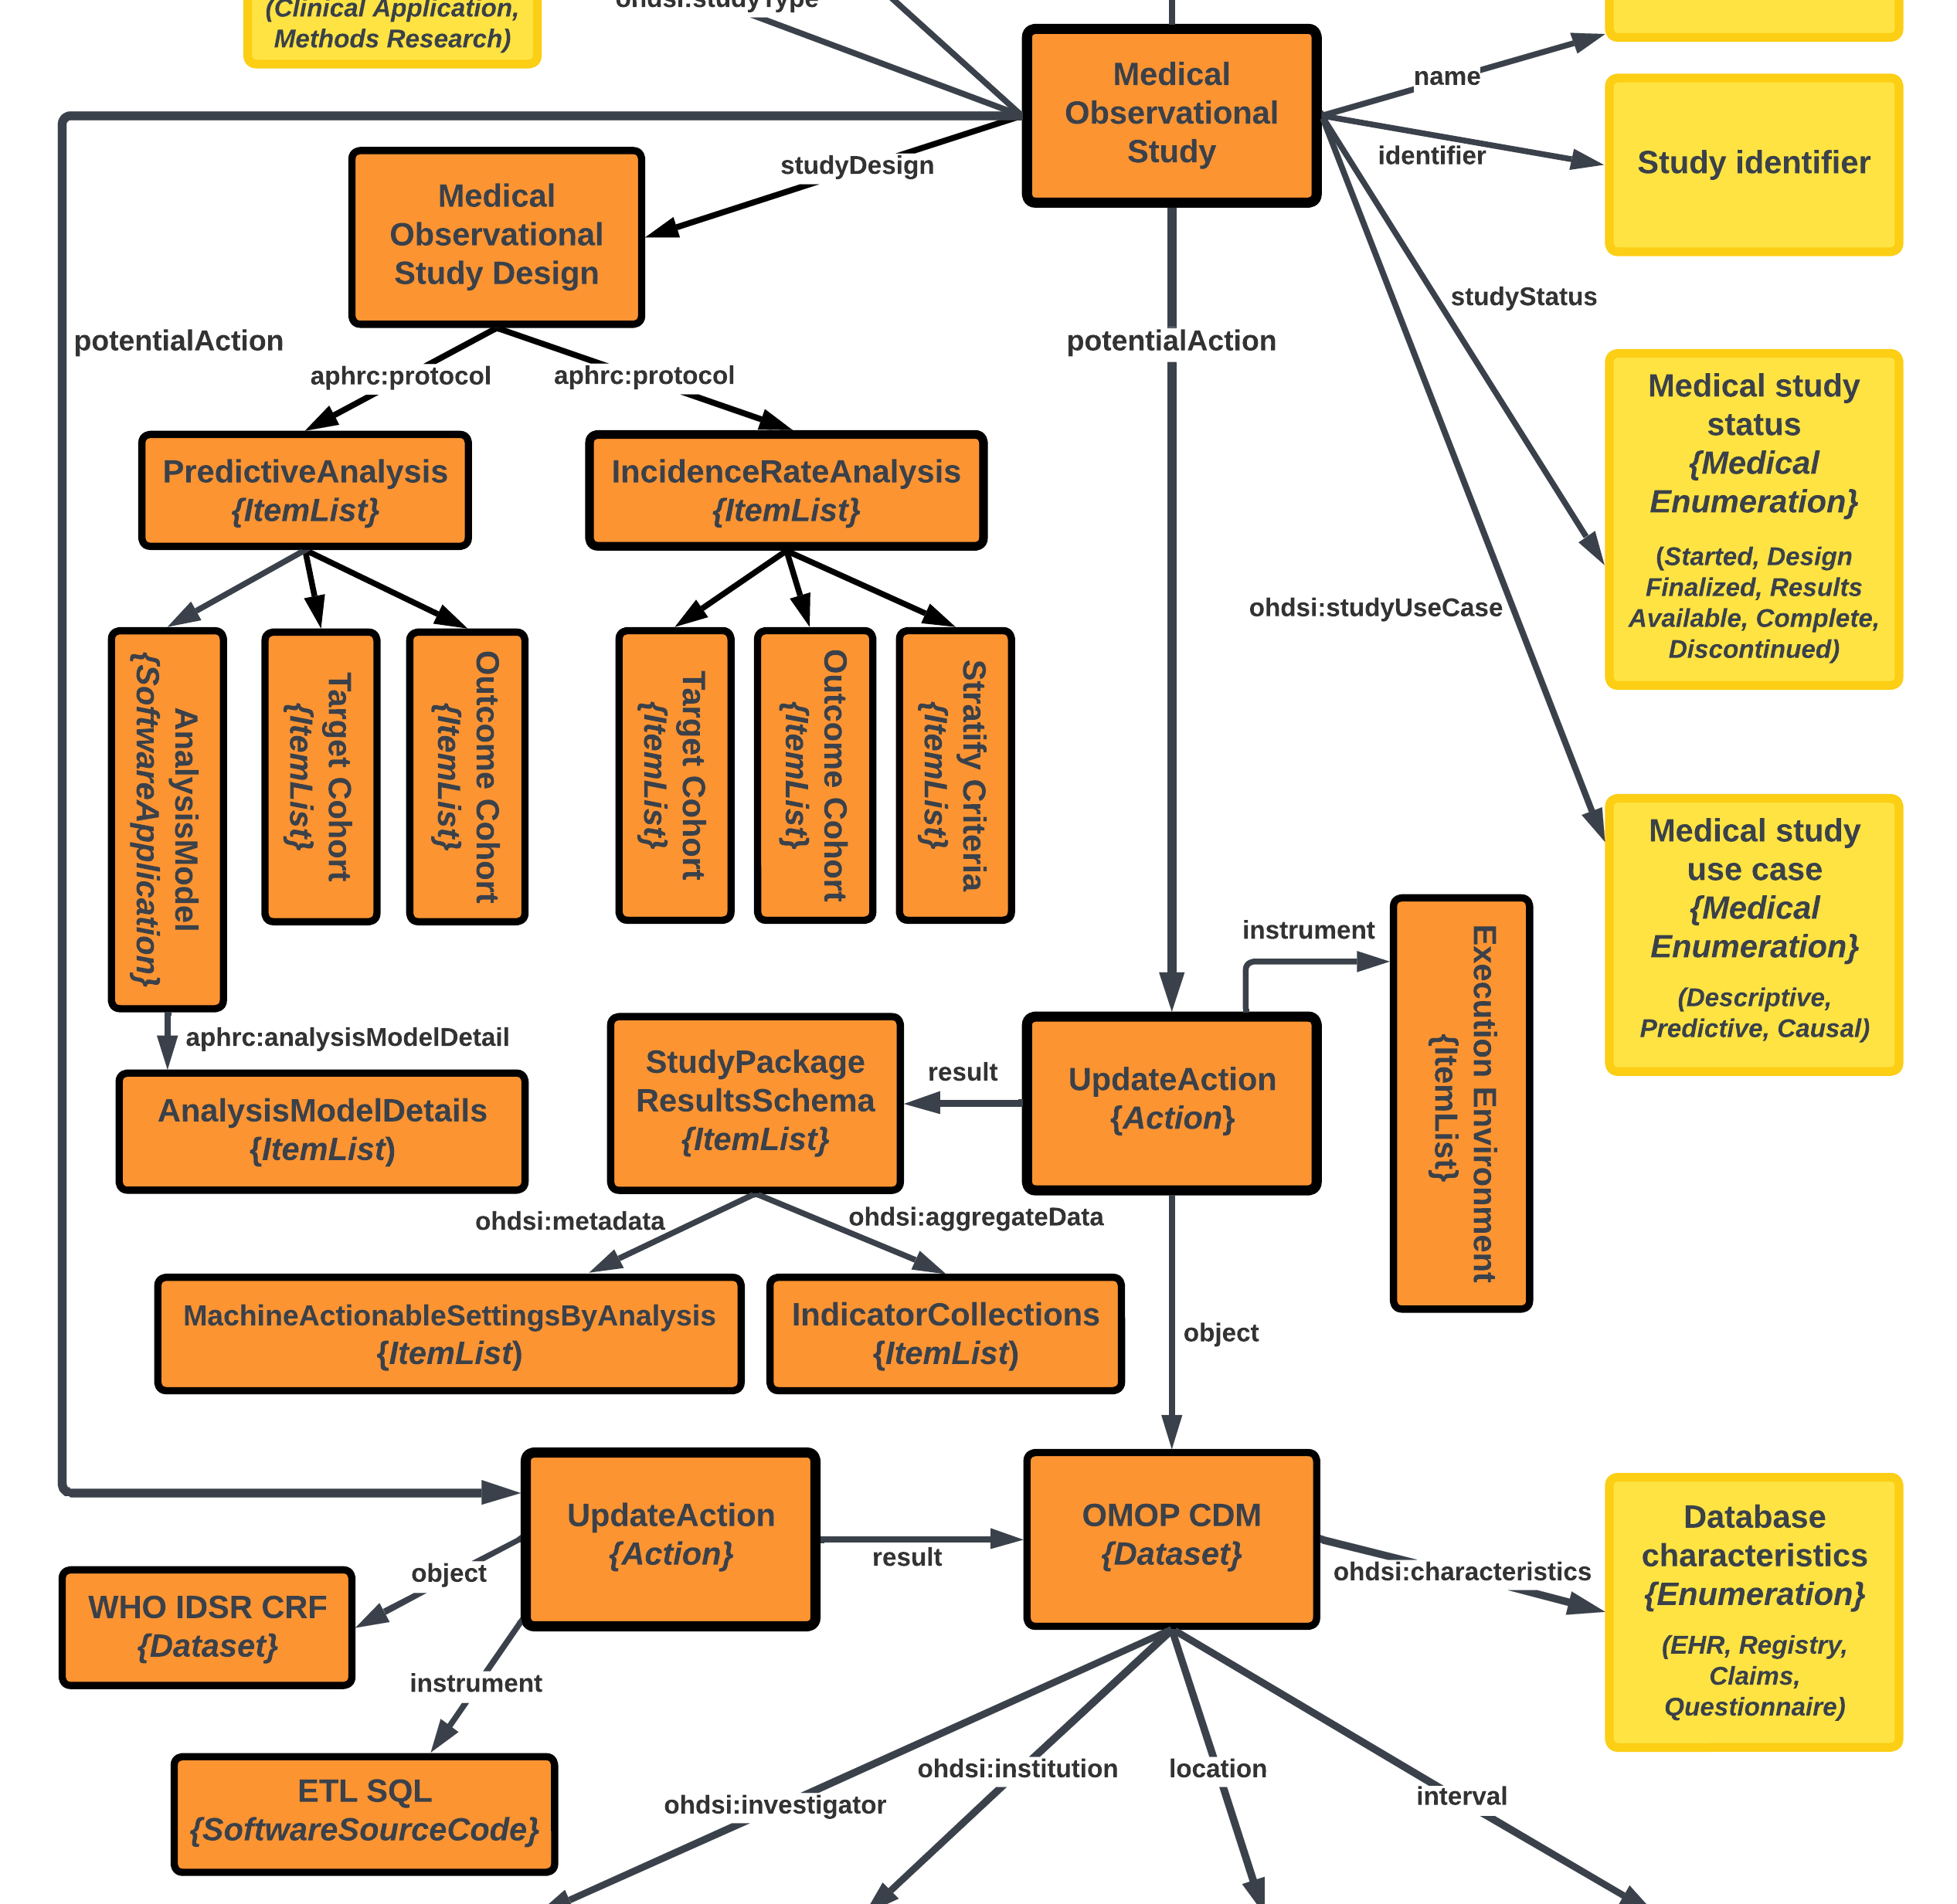
The IDSR Project Study Specification
As part of another project sponsored by the EU called WorldFAIR, INSPIRE is putting these definitions into a larger framework that documents a network study using schema.org and JSON-LD
Through this framework two workflows are described:
A site-specific workflow that produces OMOP CDM instances from source IDSR case report forms
A workflow that executes a shared study design on top of these site-specific CDMs using local copies of the same data analysis software stack

Slide 9
In an OHDSI network study, several instances of OHDSI are stood up (2)…
A second instance of OHDSI is under construction at MUBAS which hosts some Malawi Ministry of Health (MoH) IDSR case-level data
MUBAS and the Malawi MoH are currently evaluating several platforms that can host the OHDSI data analysis workbench
Meanwhile, multiple instances of the OMOP CDM – one loaded with synthetic IDSR case-level data, and one loaded with real IDSR case-level data – have been deployed
For the workbench, there are alternatives that connect an organization’s private network to a private cloud offered by Google, Microsoft and AWS
There is, also, a Docker Image alternative called Broadsea that hosts the OHDSI data analysis workbench on an application server that is part of an organization’s private network and NOT in any cloud, be it public or private

Slide 10
Meanwhile, as due diligence continues…
Malawi is ETLing IDSR case-level data into an analysis-ready data store called the OMOP CDM V5.4
This data won’t be shared. It will stay at home. And, therefore, the data would not have to be prepared for public use and undergo, either during or before the ETL, significant scrubbing aka de-identification
Instead, only the results are shared:
The results would depend on the analyses the PI(s) undertake
In an incidence rate study, we might report the rate of the outcome cohort confirmed to have COVID-19 in a target cohort of suspected cases stratified on various features of the OMOP CDM IDSR dataset
In a predictive analysis, we might report one or more prediction models that were successful, depending on the algorithms we try. This could include a convolutional neural network

Slide 11
Cohort definitions and analysis specifications are shared back and forth…
Using its ATLAS data analysis workbench, the coordinating center can export analysis specifications including their cohort definition building blocks
And MUBAS, together with other participant organisations in the network study, can import these specifications into their own workbenches
During this back and forth, first sensitivity analyses are conducted and then, iteratively, based on the results of these sensitivity analyses, new specifications are developed and validated

Slide 12
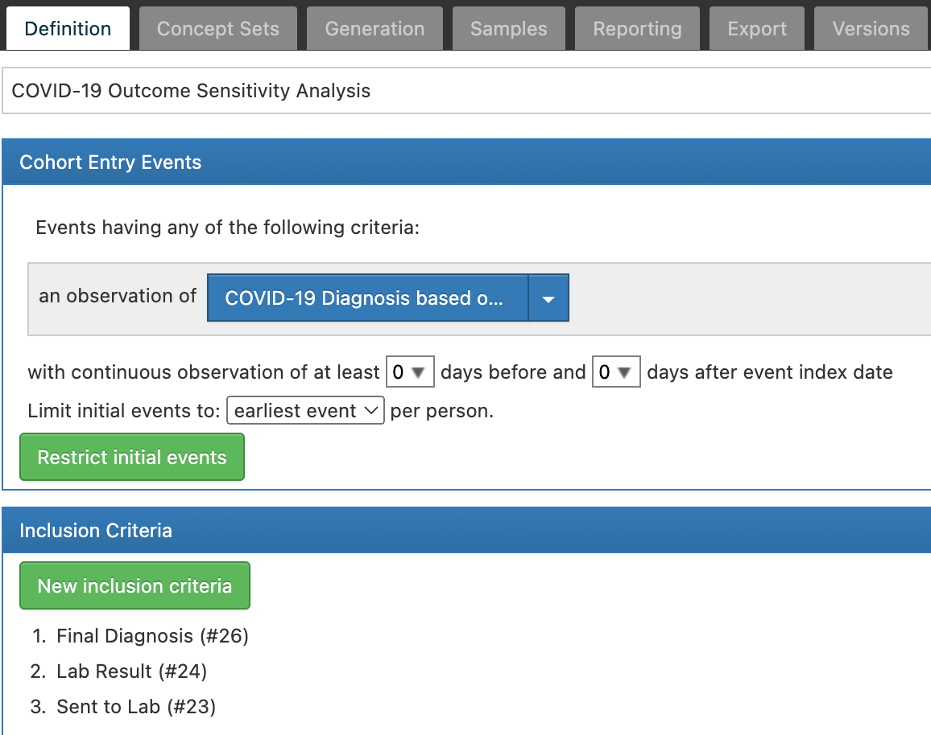
The anatomy of a sensitivity analysis
Typically, in a sensitivity analysis, there is a single cohort entry event like the occurrence of a clinical observation that you see here
This is followed by one or more inclusion criteria each of which cause attrition in the cohort first defined by the entry event

Slide 13
The anatomy of a sensitivity analysis (2)
To continue, MUBAS and/or other research partners in the network study run the sensitivity analysis on real data in an OMOP CDM
Then, based on the results, the COVID-19 outcome cohort, which might be used in multiple analyses, is developed at the coordinating center

Slide 14
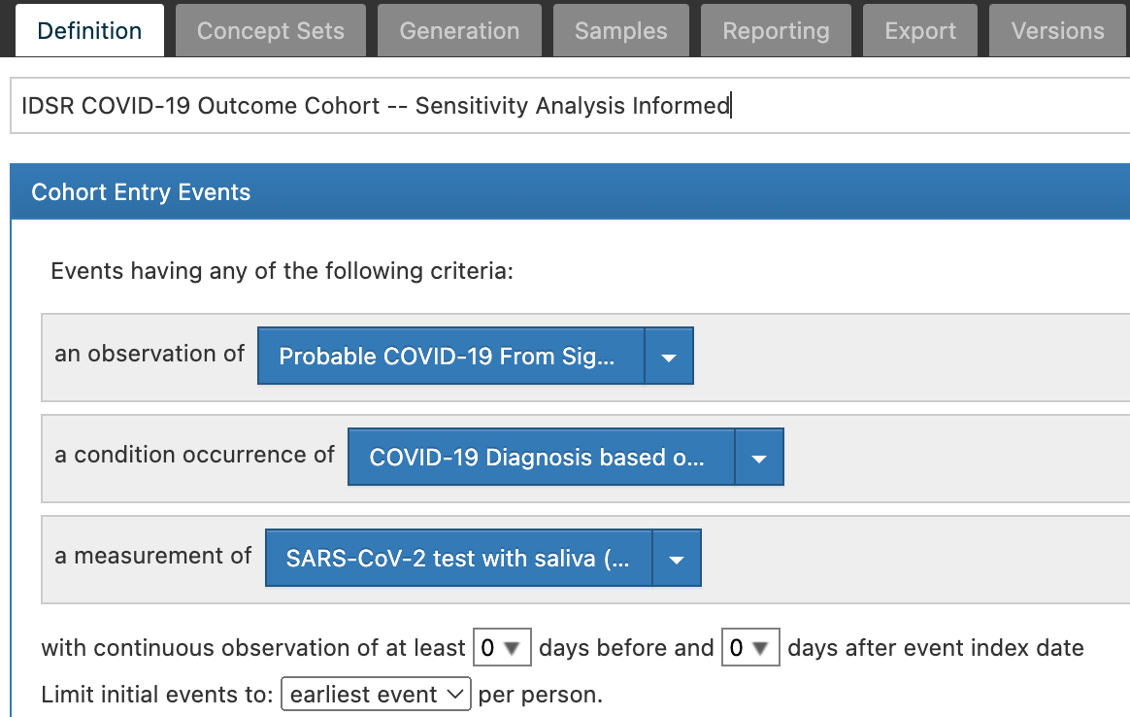
A sensitivity analysis informed outcome cohort
Guided by attrition results, an outcome cohort is fashioned with multiple entry pathways
These pathways may have been chosen to account for heterogeneous data across the network study partners
A good sensitivity analysis informed outcome cohort can “square the circle” yielding interoperability in the course of heterogeneity

Slide 15
In reality…
The IDSR under-performed in Malawi and maybe elsewhere during the 2014 Ebola outbreak
A review of the data collected in the IDSR in Malawi by MUBAS as part of the COVID-19 pandemic indicates that, while cases with positive PCR and/or antigen test results are more or less available, depending on the population (institutional more, community less), cases with negative results from both PCR and antigen testing are much harder to access digitally
One conclusion may be, given the previous issues uncovered with the IDSR during the Ebola outbreak, that the IDSR wasn’t designed to conduct large scale pcr surveillance and/or antigen surveillance during a pandemic
It does appear, however, that Malawi still made good use of the IDSR as a platform for recording several serosurveys both in institutions and in convenience/sentinel surveillance groups drawn from the community

Slide 16
In reality (2)…
Also, apart from the IDSR, additional serosurveys were undertaken in special communities during the pandemic
One serosurvey was undertaken with blood donors
A second serosurvey was undertaken with health care workers
In summary, this seems to be what happened with the IDSR in Malawi during the pandemic
The IDSR was used to conduct syndromic surveillance creating suspected cases
The IDSR was sometimes used to conduct antigen surveillance on suspected cases, creating probable cases
Probable cases didn’t as a rule receive pcr surveillance
Selectively, the IDSR was used to conduct serosurveillance on suspected and/or probable cases and/or on cases subject to sentinel surveillance
Suspected case that tested negative, no matter the test used, are not digitally accessible at present

Slide 17
In reality (3)…
The reality in Malawi and other countries -- both LMICs and HICs -- has led to research on mixed models
For example, here it has been reported that COVID-19 positive cases identified by PCR can be successfully predicted using a combination of syndromic surveillance and antigen surveillance, ignoring asymptomatic cases
And, combining “self-test surveillance” with other forms of disease surveillance including syndromic surveillance is actively being researched by the US CDC here
Also, there are new initiatives that train classifiers to distinguish, for example, influenza from COVID-19 syndromic distribution patterns during syndromic surveillance by time and place
Considering the surveillance models that the IDSR has put in play in Malawi, current research on combining surveillance models, the data situation with negatives in Malawi and the delivery timelines; these are our next steps…

Slide 18
The platform PI (still a real person) asks a research question…
Using OHDSI and ATLAS, we have prepared multiple incidence rate and predictive analyses across the several surveillance approaches we have found are in play using the IDSR in several countries
In these analyses we are defining target cohorts from two IDSR surveillance approaches (syndromic surveillance, sentinel surveillance) we have uncovered in the IDSR data. The target cohorts consist of people of interest for COVID (COVID “suspects”)
Our outcome cohorts consider the measures taken in response to these suspicions
Candidate covariates/predictors for each outcome include age, gender, residence, occupation, vaccination history, travel history, patient status (inpatient, outpatient), vaccination history, outcome when available (alive, dead, transferred out, lost to follow up or unknown) and administrative data we have about each person’s case report form
Our research question across these analyses is exploratory: what are some of the circumstances in which MoHs were able to follow or NOT the IDSR guidelines
A case for conducting multiple studies at once in OHDSI, like we are doing here, as an antidote to data dredging appears in this article

Slide 19

Study design for exploring the circumstances in which MoHs were able to follow or NOT the IDSR guidelines
Target Cohort
Population
Measures Taken
Outcome Cohort
Jails, Schools, District Hospitals
Suspected by Community Based Surveillance Focal Persons
Antigen only (Expected, Time bound)
Antigen followed by (PCR or antibody) (Expected)
Covariates include Demographics, Reporting Site, Travel History, Vaccination History, Urban/Rural and Source CRF anomalies
PCR only (Expected, Time bound)
No follow up testing (Unexpected)
Surveilled because at increased risk of exposure
Antigen only (Expected, Time bound)
PCR only (Expected, Time bound)
Antigen followed by (PCR or antibody) (Expected)
Covariates include Demographics, Reporting Site, Travel History, Vaccination History, Urban/Rural and Source CRF anomalies
No follow up testing (Unexpected)
Links here go to a text view of each cohort. The corresponding JSON definitions used for exports and imports are in the Appendix

Slide 20
Before we do a deep dive into covariates, let’s take a quick look at OHDSI’s point-and-click predictive analytics interface. The interface is a start at addressing the concerns below which INSPIRE and APHRC is continuing to address through an African-led initiative
Advances in machine learning for large dataset analysis have led to increased interest in applying patient-level prediction on this type of data. However, many published efforts in patient-level prediction do not follow the model development guidelines, fail to perform extensive external validation, or provide insufficient model details which limits the ability of independent researchers to reproduce the models and perform external validation.
From The Book of OHDSI Chapter 13

Slide 21
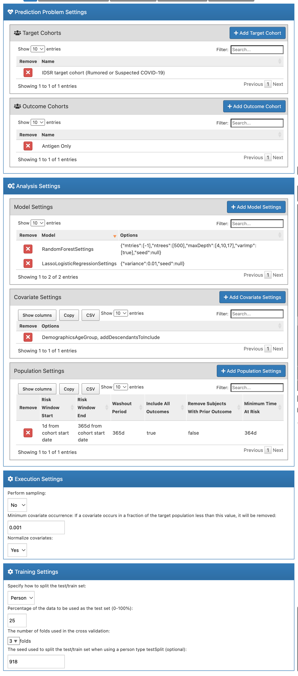
OHDSI Predictive Analytics Interface

Slide 22
OHDSI Predictive Analytics Interface (2)

Slide 23
OHDSI Predictive Analytics Interface (3)
Maybe the UI needs improvements here
Maybe the UI needs improvements here

Slide 24
The covariates may help us gain a nuanced picture of testing best practices in East Africa
This is the view that Bard takes
Bard says the best test for pandemic surveillance in Africa will depend on a number of factors, including the availability of tests, the cost of tests, and the accuracy of tests. However, some of the most promising tests for pandemic surveillance in Africa include:
Antigen tests: Antigen tests are rapid tests that can provide results in 15-30 minutes. They are less accurate than PCR tests, but they are more affordable and can be used in more settings. Antigen tests are often used for screening purposes, such as at airports or schools.
PCR tests: PCR tests are more accurate than antigen tests, but they take longer to produce results (usually 1-2 days). PCR tests are often used for diagnostic purposes, such as to confirm a suspected case of COVID-19.
Serological testing: Serological testing involves testing blood for the presence of antibodies to the COVID-19 virus. This can be used to determine how many people have been infected with the virus, even if they did not show symptoms.

Slide 25
The covariates may help us gain a nuanced picture of testing best practices in East Africa (2)
In these analyses a person’s location will serve as a proxy for the availability of tests, the cost of tests, the timeliness of tests and so forth
However, soon it may be possible to account for these and other factors more directly in OHDSI by associating people and their locations with collections of place-based exposures
This is a facility being developed by the OHDSI GIS Working Group. And one of its use cases is the IDSR and an analysis of the surveillance that African countries implemented with it during the pandemic
In fact, African countries contribute to a UN catalog of place-based variables called the Sustainable Development Goals (SDG) indicators that are broken out by geographic location (urban/rural, subnational regions).
For some examples, see here
The plan is to use a battery of these indicators in a covariate package we are developing. See the appendix

Slide 26
Using the ATLAS interface, analysts will be able to select exposures from a new location specific inventory along with data from the OMOP CDM for use in cohort definitions and as covariates
ATLAS Data Analysis Workbench
Cohort and Analysis Definitions
Covariates
Exposure Occurrence
Ingestion Geocoding
Inventory Climate Toxins Biological Agents Diet Social Factors
OMOP CDM
Occurrences Person
Location History Location
ATLAS will create just in time exposure occurrences for analysis
An exposure stimulus** concept taken from a standard exposure or social determinants of health vocabulary
C
**Exposure stimulus is an ECTO class. This and other classes in ECTO are part of an “upper model” that plays host to many external ontologies. See appendix…
Suspected Antigen only PCR only No follow up testing
Person characteristics Locally specific, temporally bound SDG* exposure occurrences Other occurrences
Signs and symptoms Preliminary diagnosis Measurements
Final diagnosis
UN SDG* indicators API
*Sustainable Development Goals

Slide 27
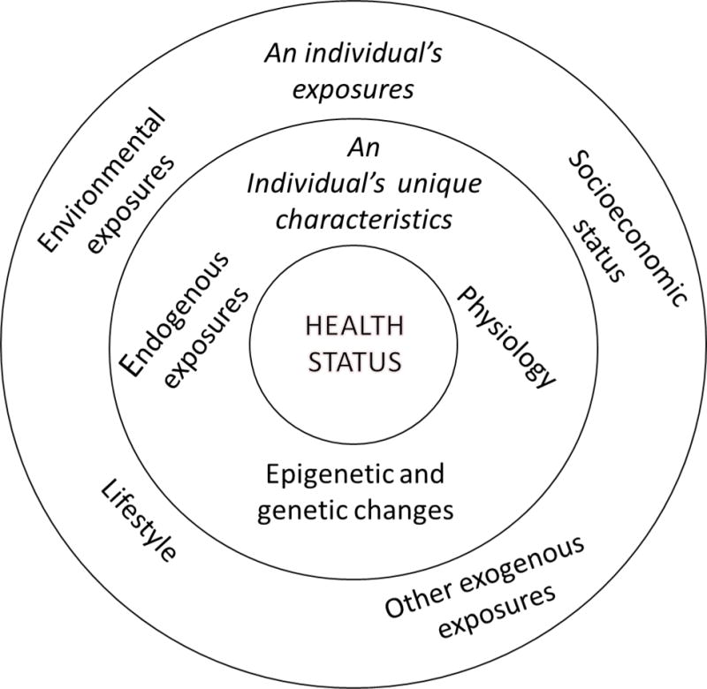
In an updated ATLAS data analysis workbench, we are adding the external exposome in support of the IDSR and other use cases
External exposome
From Use of the Exposome in the practice of epidemiology
Internal exposome

Slide 28
Growing analysis and cohort definitions through collaboration
2. Conduct study analyses with synthetic data
3. Tweak the analyses and/or the synthetic data and run again
4. Conduct sensitivity analyses using the definitions with MoH data
5. Modify the definitions based on the sensitivity analyses
1. Specify study using the ATLAS data analysis workbench
The lifecycle of a network study is just starting when we execute the study with synthetic data (Stage 1)
There are many steps that follow because a study definition containing one or more analyses and their building blocks (cohort definitions and their concept sets) is iterative
Here you see the lifecycle…
A Network Study Metadata Repository
Analysis and cohort
definitions
Analysis and cohort definitions
Analysis and cohort definitions
Push
Push
Pull

Slide 29
Growing analysis and cohort definitions through collaboration (2)
2. Conduct study analyses with synthetic data
3. Tweak the analyses and/or the synthetic data and run again
4. Conduct sensitivity analyses using the definitions with MoH data
5. Modify the definitions based on the sensitivity analyses
1. Specify study using the ATLAS data analysis workbench
Right now, in the IDSR project we are completing Stage 3 and beginning Stage 4 where we are starting to conduct sensitivity analyses with the various study definitions using Malawi MoH data
Our impression so far is that some Malawi data may be missing with so many people in need of monitoring
Sensitivity analyses will help us evaluate data alternatives from one site to another across the network study
A Network Study Metadata Repository
Analysis and cohort
definitions
Analysis and cohort definitions
Analysis and cohort definitions
Push
Push
Pull

Slide 30
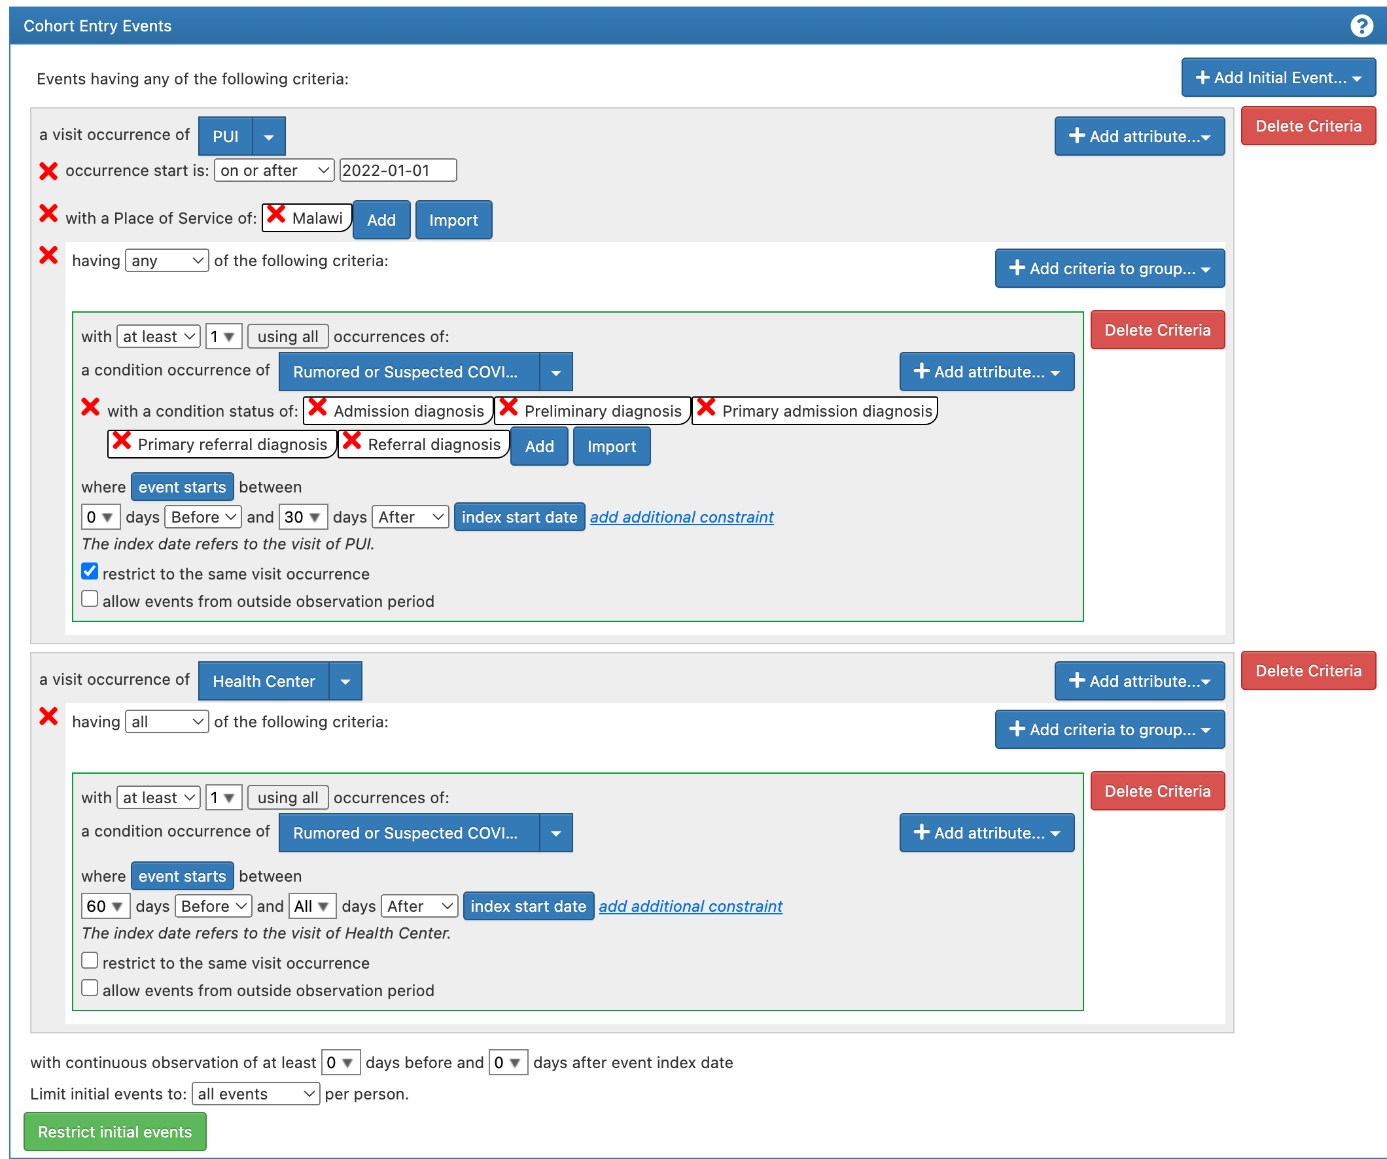
We specify and run a “real” target cohort definition for suspected COVID-19 cases alongside a “theoretical” one, iteratively growing the “real” one to cover as many features as possible from the theoretical one while simultaneously maximizing the cohort size
Target cohort in theory
Target cohort informed by data

Slide 31
The methodology…
In this approach we successively append paths through which a person can enter the cohort
Each path is really its own cohort which keeps and modifies features from the previous version
Only we keep all the versions together in a single cohort definition as a record we can use to both trace and evaluate what successive updates do
Cohort Definition
Feature 1
Feature n
Update #1
Feature 1
Feature n
Update #n
Feature 1
Feature n

Slide 32
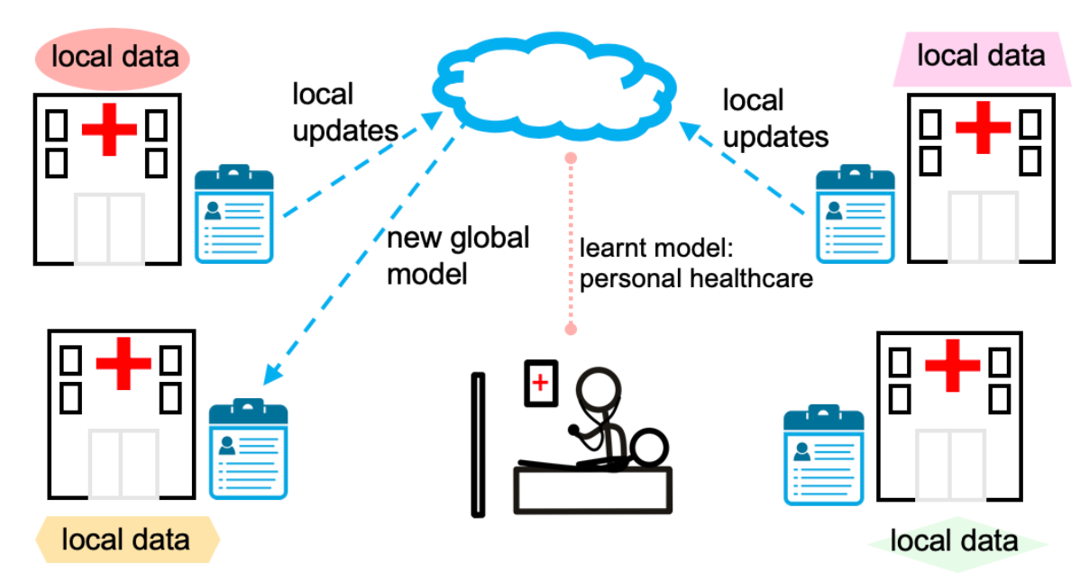
This lifecycle leads us into a federated learning model where the team is encountering many open questions we are working with OHDSI and other research scientists to understand and master using AI
Across the local models, when it comes to cohort definitions, after sensitivity analysis, there may be concept drifts (same labels, different features), concept shifts (same features, different labels) and/or covariate shifts (a function of differences in the test data)
From Federated Learning: Challenges, Methods, and Future Directions

Slide 33
Our biggest problem we think is concept drift. Are the analyses we perform the same when we substitute certain events in the OMOP CDM for others if, for example, we are missing a diagnosis or the results of a PCR test?
Across the local models, when it comes to cohort definitions, after sensitivity analysis, there may be concept drifts (same labels, different features), concept shifts (same features, different labels) and/or covariate shifts (a function of differences in the test data)
From Federated Learning: Challenges, Methods, and Future Directions

Slide 34
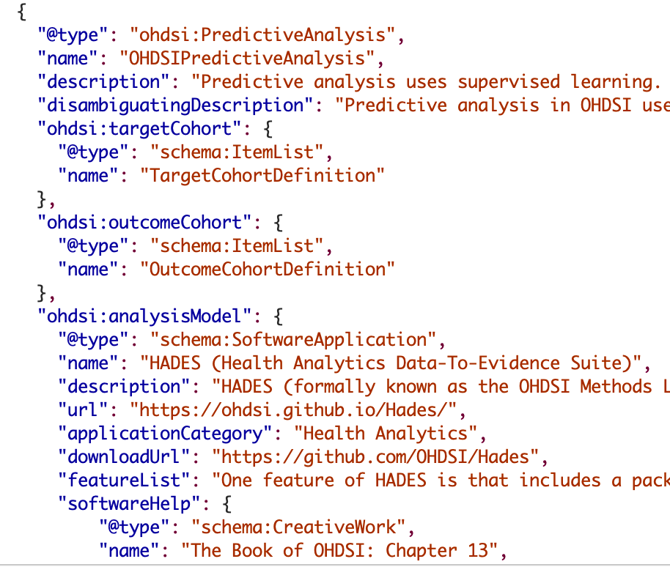
The End

Slide 35
Appendix

Slide 36
JSON cohort definitions
IDSR target cohort (Rumored or Suspected COVID-19)
IDSR target cohort (Sentinel Surveillance)
Antigen only
PCR only
Antigen Followed by PCR or Antibody
No follow up testing

Slide 37
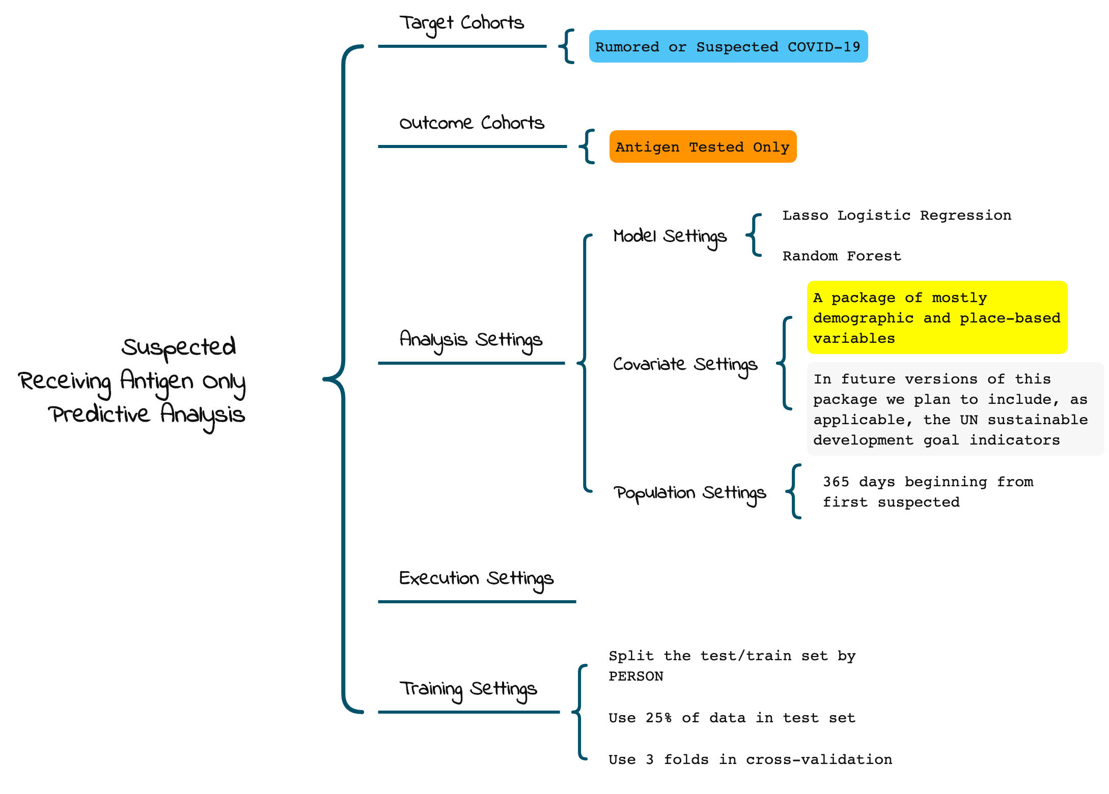
Example predictive analysis

Slide 38
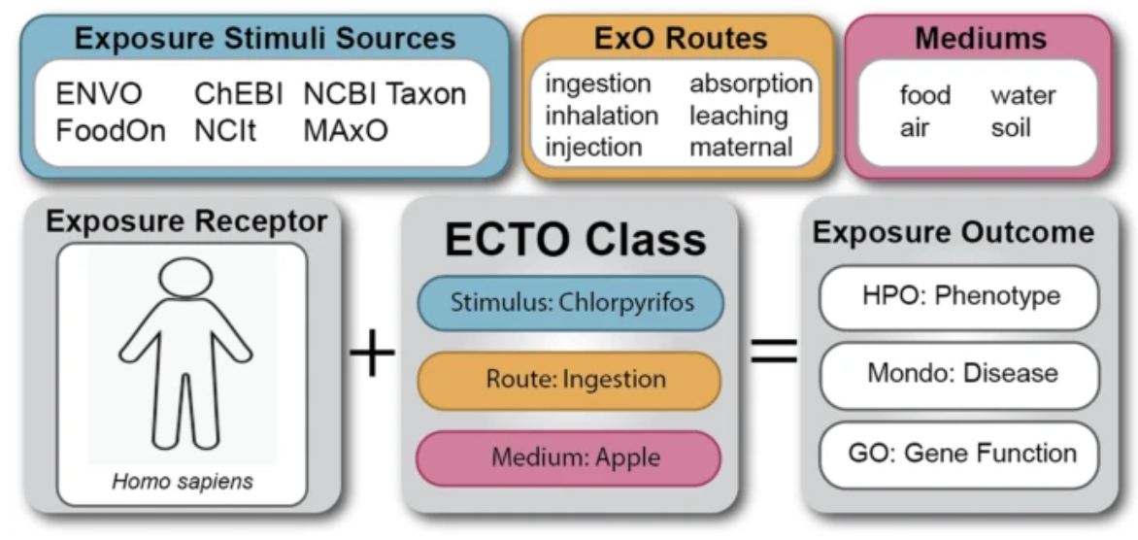
I don’t know how much we want to subscribe to a single framework that unifies exposure attributes
ECTO unifies exposure attributes. Existing ontologies contain terms describing common exposure stimuli, exposure routes, and potential exposure media, however unifying terms to describe the exposure process were not yet represented. Utilizing the schema of the Exposure Ontology (ExO), ECTO classes can coordinate the stimulus, route, and exposure components into a single process term for consistent exposure classes. Logical axioms can be used to define the relationships between exposure receptors, ECTO classes, and documented exposure outcomes from the literature. Instance level schemas can also be developed using individual data points as the exposure receptor or exposure outcomes. Abbreviations: ENVO, The Environment Ontology; ChEBI, Chemical Entities of Biological Interest; NCBI Taxon, National Center for Biotechnology Information Taxonomy; FoodOn, Food Ontology; NCIt, National Cancer Institute Thesaurus; MAxO, Medical Actions Ontology; HPO, Human Phenotype Ontology; Mondo, Mondo Disease Ontology; GO, Gene Ontology

